Slide 1
Programming Fundamnetals Using C++
Maryam Omar

Slide 2
Content
C++ Vs. Python
Structure of Simple C++ Program
Data Types
Keywords
Variables
Escape sequence
Standard Input
Arithmetic Operators
Syntax and Logical errors.

Slide 3
C++ Vs Python
Introduction
Usage
Compilation
Performance
Scope of Variables
Functions
https://www.edureka.co/blog/python-vs-cpp/

Slide 4
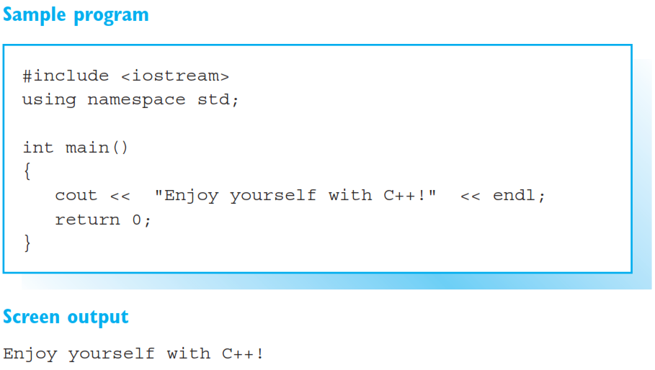
Beginner’s C++ Program

Slide 5
Structure of a simple C++ program
#include<iostream>
First line starts with # which indicates that line is intended for preprocessor.
Iostream header file compromises of conventions for input and output stream.
Using namespace std:
Predefined names in c++ are found in std(standard) namespace.
Int main()
All C++ programs starts with main.

Slide 6
{ }
Brackets in C++ defines the scope.
Return 0:
Terminates the main function. ) indicates that program has been executed successfully.
;
Semicolon in C++ indicates that line has been ended.
endl;
Endl(end of line) causes a line feed.

Slide 7
Comments
String enclosed in /* */ or that starts with // are interpreted as comments.
/* */ is used to cover several lines.
// is used to cover single line.

Slide 8
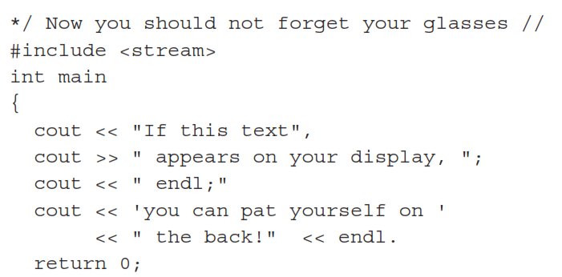
Task
The following program contains several errors:
Resolve the errors and run your program again to test.

Slide 9
Data Types
A program can use/store several type of data to solve a given problem for example characters, integers, floating points.
Computer uses different methods for processing and storing data thus the “data type” must be known.

Slide 10
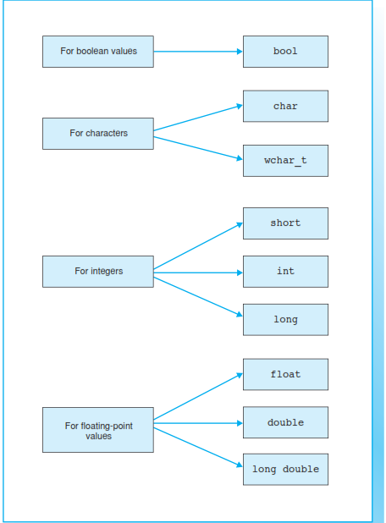

Slide 11
Task
Explore how much memory is allocated to each data type?

Slide 12
Keywords
Keyword is a predefined or reserved word in C++ library with a fixed meaning and used to perform an internal operation.
C++ Language supports more than 64 keywords.
Keywords are those words whose meaning is already defined by Compiler.
These keywords cannot be used as an identifier.

Slide 13
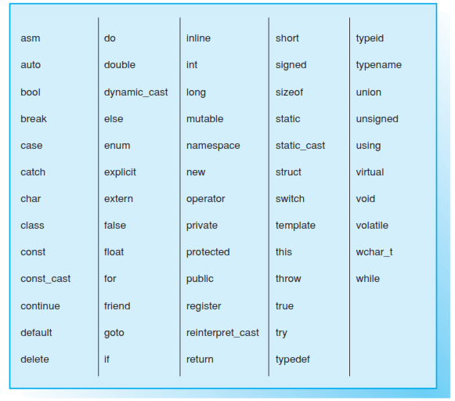
Keywords in C++

Slide 14
Variables
In C++ a name can be assigned to a data.
The data can be access by that particular name.
Once a name is assigned, different values of same data type can stored/overwrite, thus called “variables”.
Syntax:
Datatype variablename;
Datatype variablename=initialization value;

Slide 15
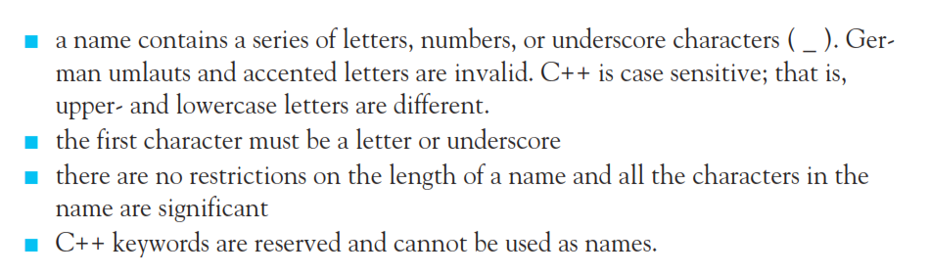
Conventions for Naming a Variable

Slide 16
Task
Write a C++ code to create/declare and initialize variable of following datatypes:
int
float
bool
Long
Print their values on screen as well.

Slide 17
Escape Sequences
In cout statement, non graphic characters can be expressed by means of escape sequence.
In cout statement, escape sequences are started with back slash (/)
Some common escape sequences:
\n new line
\t horizontal tab
\” double quotes
\’ single quote
\? Question Mark
\\ back slash

Slide 18
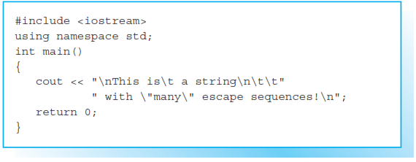
Example

Slide 19
Task
The sizeof operator can be used to determine the number of bytes occupied in memory by a variable of a certain type. For example sizeof(short) is equivalent to 2.
Write a C++ code to determine the size of memory required by each datatype.

Slide 20
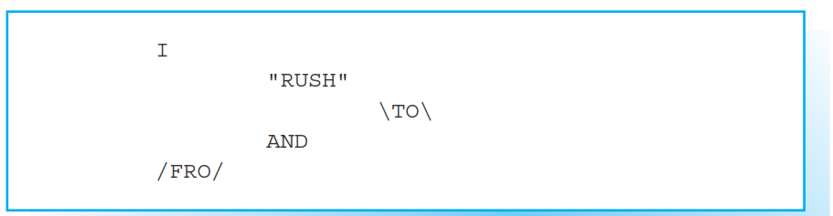
Task
Write a C++ code to generate screen output using escape sequences as:

Slide 21
Task
Write a C++ code that declare two variables for floating points numbers and initialize them with following values:
2.464
67.121
Then display the sum and difference of these two numbers on your screen.

Slide 22
Standard Input (Cin)
cin is used together with the extraction operator >>.
This operator is then followed by the variable where the extracted data is stored.
Example:
Int a;
Int b;
cin >> a >> b; or cin >> a
cin >> b

Slide 23
Arithmetic Operator
C++ uses operators to do arithmetic. It provides operators for five basic arithmetic calculations:
Addition (+)
Subtraction (-)
Multiplication (*)
Division (/)
Modulus (%)
Each of these operators uses two values (called operands) to calculate a final answer

Slide 24
Syntax Error
In computer science, a syntax error is an error in the syntax of a sequence of characters that is intended to be written in a particular programming language.
For compiled languages, syntax errors are detected at compile-time. A program will not compile until all syntax errors are corrected.
(wikipedia)

Slide 25
Logical Error
In computer programming, a logic error is a bug in a program that causes it to operate incorrectly, but not to terminate abnormally (or crash).
A logic error produces unintended or undesired output or other behavior, although it may not immediately be recognized as such.
(Wikipedia)

Slide 26
Identify syntax and logical errors in following programs.

Slide 27
Problem 1
#include <iostream>
using namespace std;
int main() {
int n1, n2, d1;
// Get two numbers from the user
cin << n1 << n2;
// Compute sum of the two numbers
cout << n1 + n2 << '\n';
// Compute average of the two numbers
cout << n1+n2/2 << '\n';
// Assign some variables
d1 = d2 = 0; // 5
// Compute a quotient
cout << n1/d1 << '\n';
// Compute a product
n1*n2 = d1;
// Print result
cout << d1 << '\n';
}

Slide 28
Problem 1: Syntax Errors
#include <iostream>
using namespace std;
int main() {
int n1, n2, d1;
// Get two numbers from the user
cin << n1 << n2;
// Compute sum of the two numbers
cout << n1 + n2 << '\n';
// Compute average of the two numbers
cout << n1+n2/2 << '\n';
// Assign some variables
d1 = d2 = 0; // 5
// Compute a quotient
cout << n1/d1 << '\n';
// Compute a product
n1*n2 = d1;
// Print result
cout << d1 << '\n';
}
---------------------------------→ extraction operator should be used
-----------------------------------→syntax error ['d2' was not declared in this scope]
-----------------------------------------→syntax error [required as left operand of assignment]

Slide 29
Problem 1: Logical Error
#include <iostream>
using namespace std;
int main() {
int n1, n2, d1;
// Get two numbers from the user
cin << n1 << n2;
// Compute sum of the two numbers
cout << n1 + n2 << '\n';
// Compute average of the two numbers
cout << n1+n2/2 << '\n';
// Assign some variables
d1 = d2 = 0; // 5
// Compute a quotient
cout << n1/d1 << '\n';
// Compute a product
n1*n2 = d1;
// Print result
cout << d1 << '\n';
}
-------------------------- -------→ n1 is divided by zero which is infinity, thus a logical error

Slide 30
Problem 2
#include <iostream>
int main() {
double C, r;
const double PI = 3.14159;
// Formula for the area of a circle given its radius
C = 2*PI*r;
// Get the radius from the user
cout >> "Please enter the circle's radius: ";
cin << r;
// Print the circumference
cout << "Circumference is " << C << '\n';
}

Slide 31
Problem 2: Syntax Errors
#include <iostream>
Using namespace std;
int main() {
double C, r;
const double PI = 3.14159;
// Formula for the area of a circle given its radius
C = 2*PI*r;
// Get the radius from the user
cout << "Please enter the circle's radius: ";
cin >> r;
// Print the circumference
cout << "Circumference is " << C << '\n';
return 0;
}

Slide 32
Problem 2: Logical Errors
#include <iostream>
Using namespace std;
int main() {
double C, r;
const double PI = 3.14159;
// Formula for the area of a circle given its radius
C = 2*PI*r;
// Get the radius from the user
cout << "Please enter the circle's radius: ";
cin >> r;
// Print the circumference
cout << "Circumference is " << C << '\n';
return 0;
}
We are calculating circumference first BUT Taking radius as an input from user later.

Slide 33
Task
This codes takes an radius as an input from user and calculates area of a circle
Fix syntax and logical errors and run the program
#include <istream>
int main[] {
double C, r;
const double PI = 3.14159;
// Formula for the area of a circle given its radius
C = PI * r ^2
Get the radius from the user
cout >> "Please enter the circle's radius: ";
cin << r;
PI = 3.14568;
// Print the AREA
cout < “Area is " << C < '\n';
}

Slide 34
Task
Take any number as an input between 1 -1000 from user and display its table upto 10.

Slide 35
Task
Write a C++ code that takes radius as an input from user and calculate area and circumference of a circle.

Slide 36
Task
Write a C++ code that takes length of a square as an input from user and calculate its area and parameter.

Slide 37
Task
Write a C++ code that takes length and width of a rectangle as an input from user and calculate its area and parameter.

